Slide 1
Description of EM Wave

Slide 2
Biot - Savart law is used to calculate the magnetic field due to a current carrying conductor.
According to this law, the magnitude of the magnetic field at any point P due to a small current element I.dl ( I = current through the element, dl = length of the element) is,

Slide 3
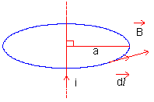
Ampere’s circuital law
It states that the line integral of the magnetic field (vector B) around any closed path or circuit is equal to μ₀ (permeability of free space) times the total current (I) flowing through the closed circuit.
Mathematically,

Slide 4
Electromagnetic waves
According to Maxwell’s modification of Ampere’s law, a changing electric field gives rise to a magnetic field.
It leads to the generation of electromagnetic disturbance comprising of time varying electric and magnetic fields.
These disturbances can be propagated through space even in the absence of any material medium.
These disturbances have the properties of a wave and are called electromagnetic waves.

Slide 5
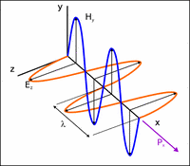
Representation of Electromagnetic waves

Slide 6
Description of EM Wave
The variations of electric intensity and magnetic intensity are transverse in nature.
The variations of E and H are perpendicular to each other and also to the directions of wave propagation.
The wave patterns of E and H for a traveling electromagnetic wave obey Maxwell’s equations.

Slide 7
Description of EM Wave
EM waves cover a wide range of frequencies and they travel with the same velocity as that of light i.e. 3 × 10 8 m s ^{– 1}.
The EM waves include radio frequency waves, microwaves, infrared waves, visible light, ultraviolet rays, X – rays and gamma rays.

